Slide 1

Demand Elasticity, Supply Elasticity
Meaning and concept

Slide 2
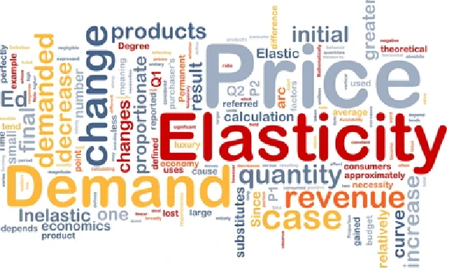
DEMAND ELASTICITY

Slide 3
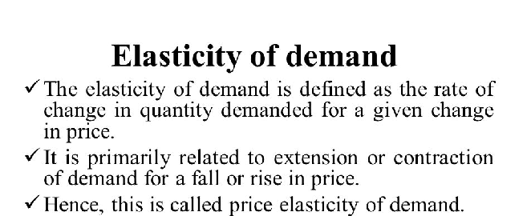
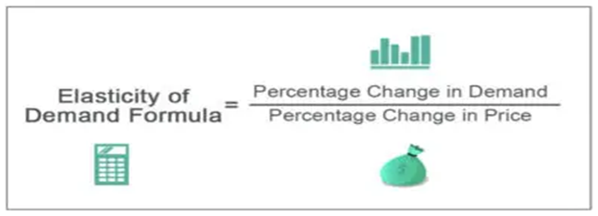
Meaning of Demand and Demand elasticity

Slide 4
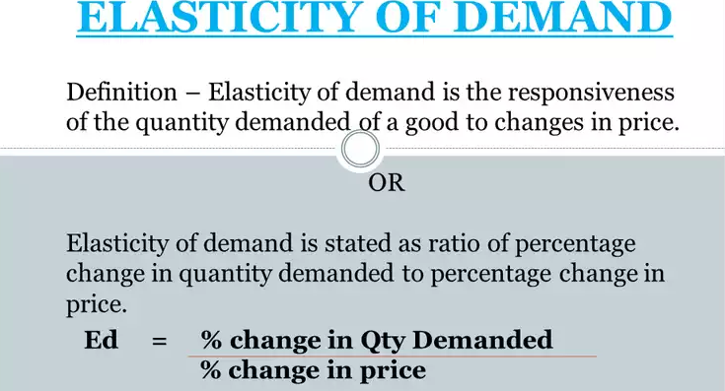

Slide 5
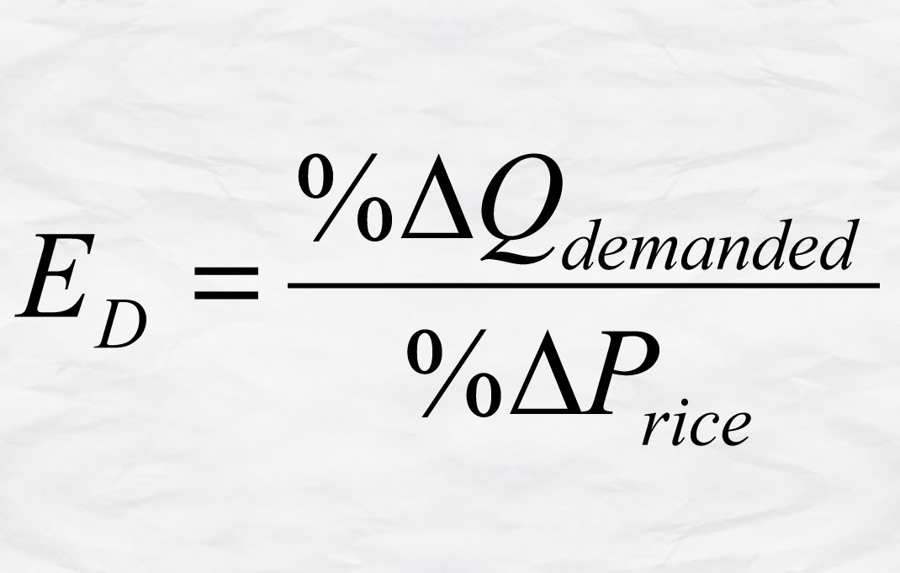

Slide 6
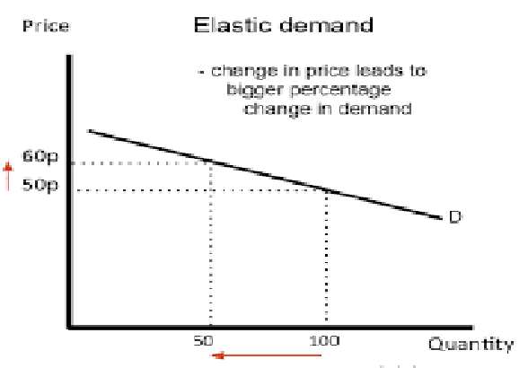

Slide 7
Elasticity of Demand

Slide 8
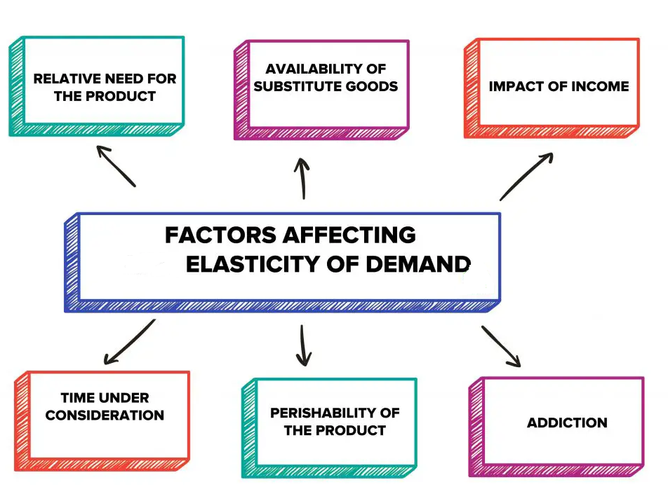

Slide 11
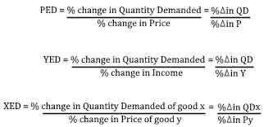

Slide 12
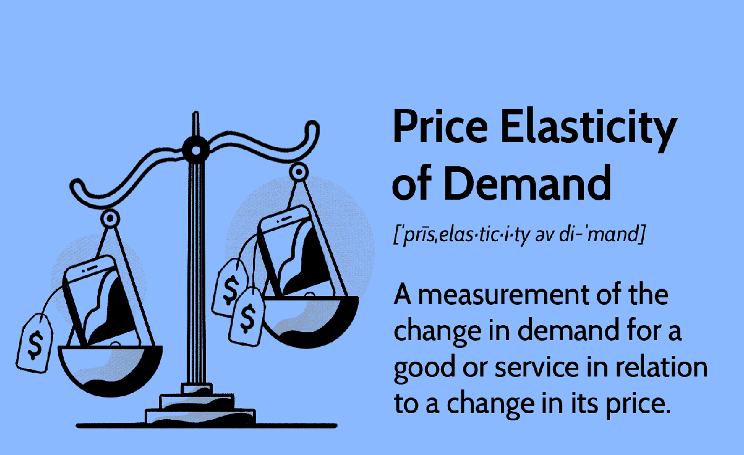
PRICE ELASTCITY OF DEMAND

Slide 13
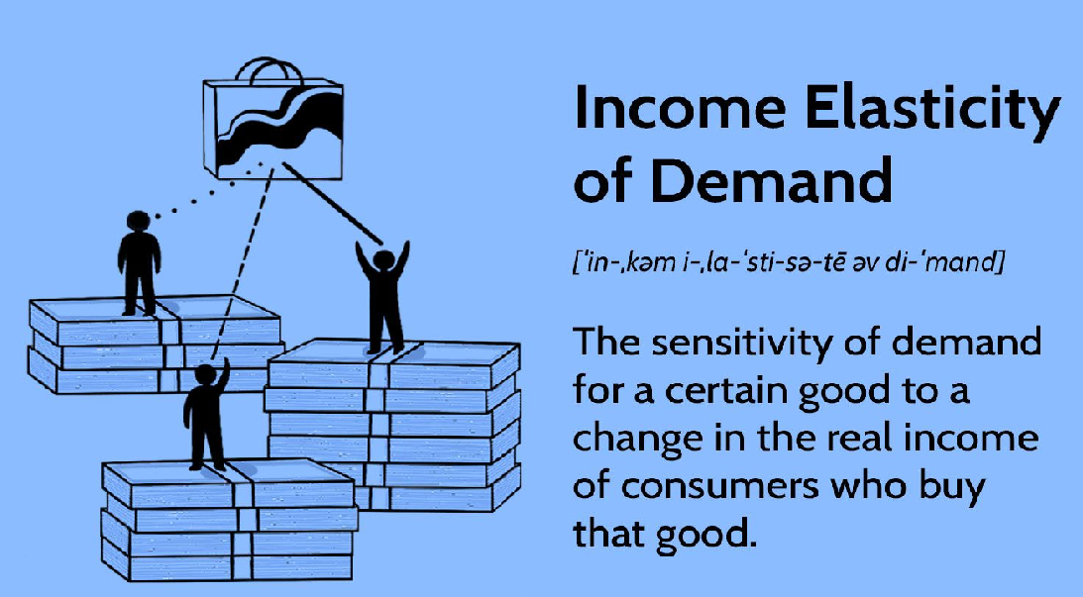
INCOME ELASTICITY OF DEMAND

Slide 14
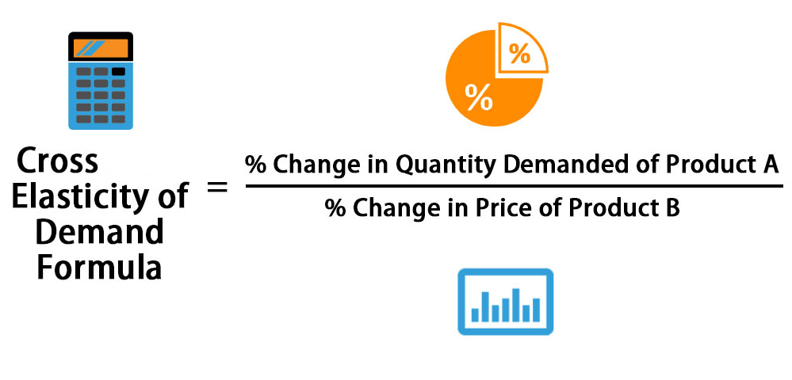
CROSS ELASTICITY OF DEMAND

Slide 15
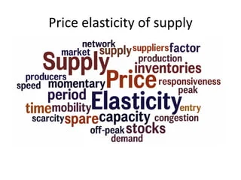
SUPPLY ELASTICITY

Slide 16
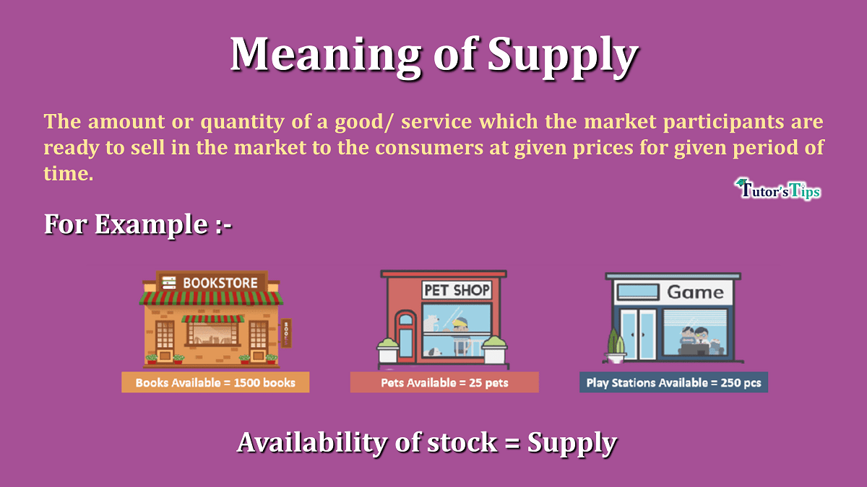
MEANING OF SUPPLY AND SUPPLY ELASTICITY

Slide 17
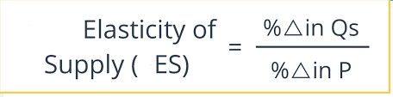
FORMULA OF ELASTICITY OF SUPPLY

Slide 18
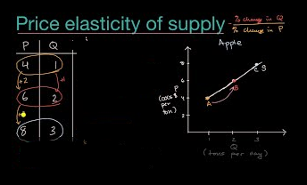

Slide 19
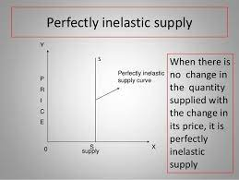
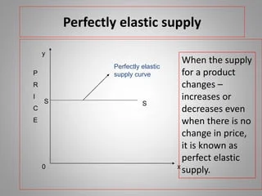
ELASTICITY OF SUPPLY

Slide 20
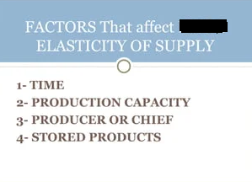

Slide 21
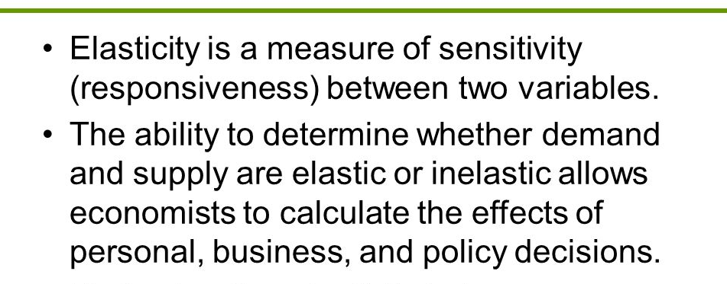
CONCLUSION

